Slide 1

Human Pose and reaction Classification
Mennatullah Mahmoud 18101713
Menna Abdelsattar 18101590
Nada Tamer 18102291

Slide 2
Introduction
Human action recognition is one of the most successful applications of pattern recognition and image analysis which has recently received significant attention, especially during the past several years.
Human actions detection is very much investigated in utilization of artificial intelligence and computer vision.
Effective action recognition strategies have demonstrated and the action information are successfully gained from motion videos and pictures.
In this project, image processing techniques are used in order to recognize different actions of the human body, also human face reactions.

Slide 3
Our Project
Our project is divided into 2 sections:
1- A detection system that recognize human actions like walking, standing, sitting, running, jumping and waving.
2- It recognizes human face reactions like happy, sad and surprised.

Slide 4
The pipeline of each section:
1) Collecting Dataset
2) Collecting key points from the dataset and save it to a csv file using mediapipe
3) Machine Learning model to be trained to recognize the activity or the reation
4) Testing our model
We build the system using python programming language: Mediapipe library for collecting key, sklearn for machine learning models and other helping libraries as pandas , cv and others

Slide 5
MediaPipe
MediaPipe is a cross-platform framework for building multimodal applied machine learning pipelines. MediaPipe is a framework for building multimodal (eg. video, audio, any time series data), cross platform (i.e Android, iOS, web, edge devices) applied ML pipelines.
We used MediaPipe Pose and MediaPipe Face Mesh

Slide 6
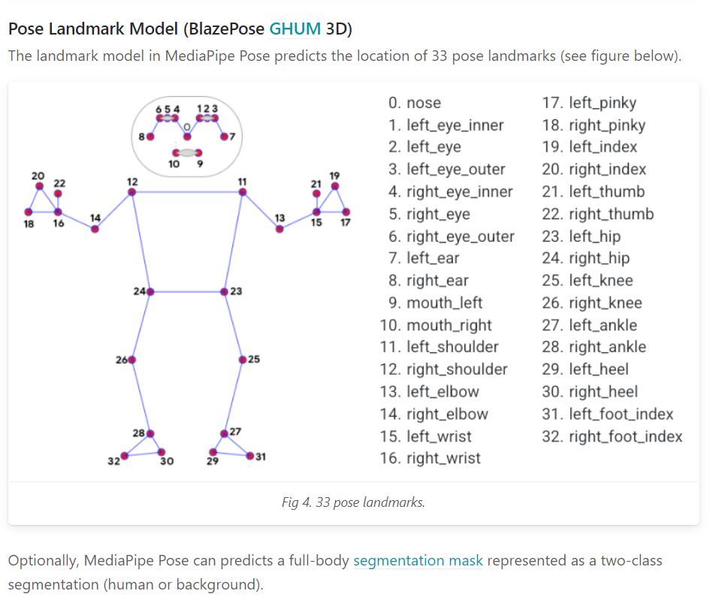
MediaPipe Pose
MediaPipe Pose is a ML solution for high-fidelity body pose tracking, inferring 33 3D landmarks and background segmentation mask on the whole body from RGB video frames

Slide 7
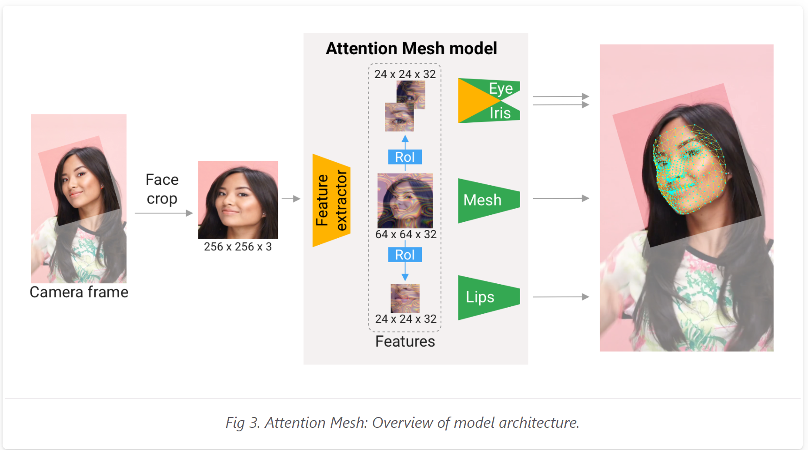
MediaPipe Face
MediaPipe Face Mesh is a face geometry solution that estimates 468 3D face landmarks in real-time even on mobile devices

Slide 8

Our Steps
Our project includes:
- Dataset
- Collecting Key points
- Machine Learning Model

Slide 9
Pose Detection

Slide 10
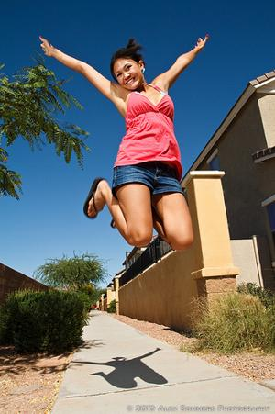
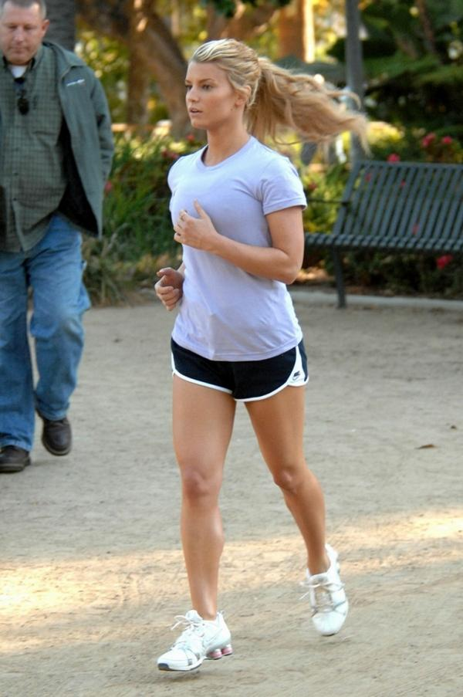

Dataset
We used “Stanford” website to download dataset of human actions. The dataset is composed of 40 categories(actions).
The categories include 9532 type jpg images.
The used actions are: “jumping”, “running” and “waving”.
jumping
running
waving

Slide 11
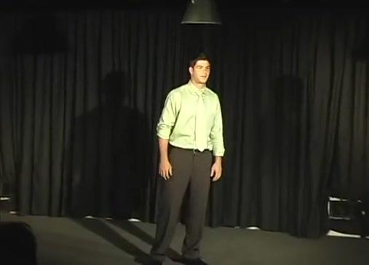
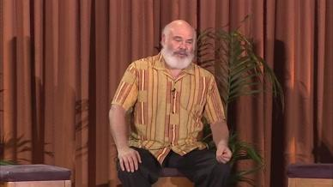
Dataset
We used “Robots” website to download dataset of human actions. Its name is YouTube Pose dataset. The dataset is composed of 50 categories
We used “Standing” and “Sitting” categories from this dataset
Standing
Sitting

Slide 12
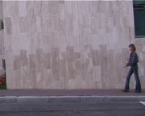
Dataset
Walking video
From “Github”, we downloaded dataset of human actions videos. Its name is Action recognition master. The dataset is composed of 10 categories(actions).
each category include 10 type avi videos.
The used action videos are: “walking”, “jumping”, “running” and “waving” .

Slide 13
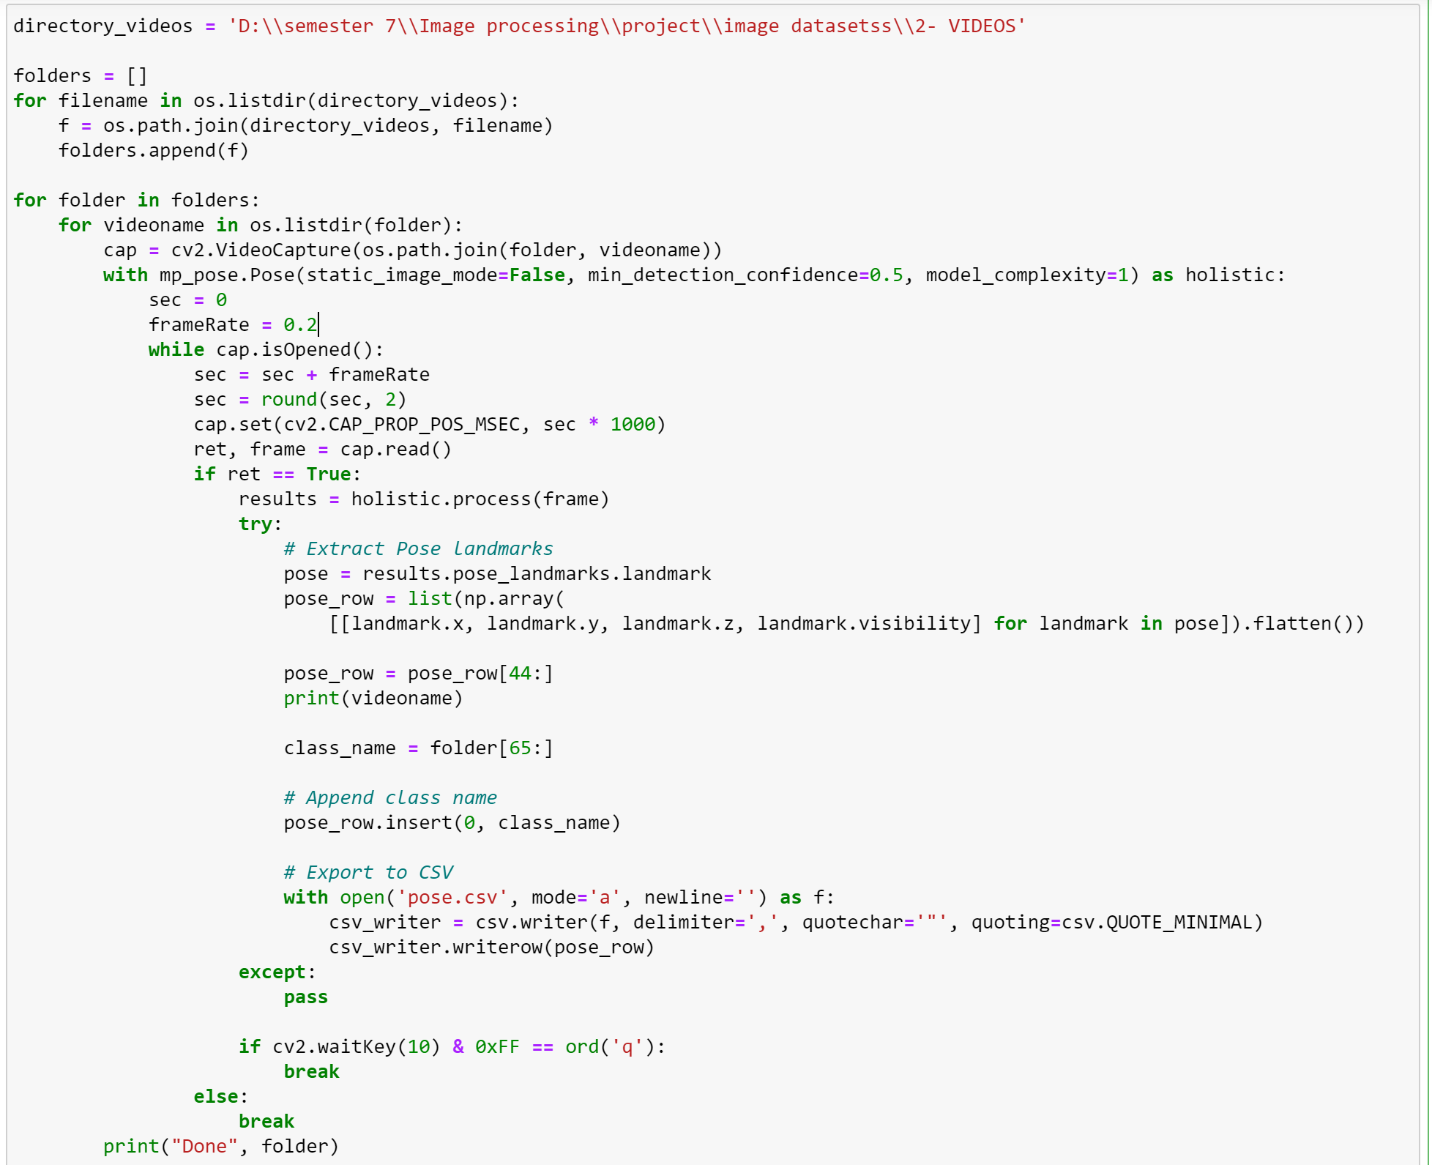
Detecting keypoints

Slide 14
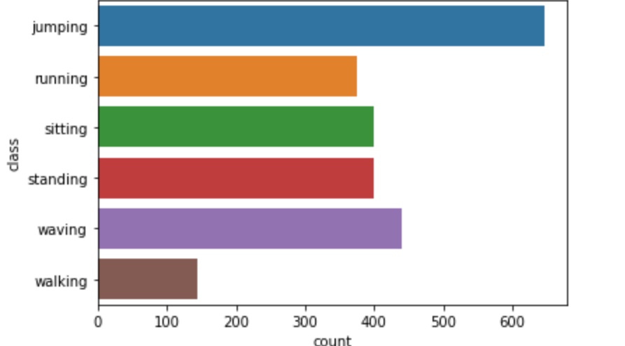
Data Exploration
Our Data became 2407 row and 84 columns (23 feature excluding face * 4 coordinates)
Jumping has 646 record, waving has 441, sitting has 400, standing has 400, running has 375 and walking has 144.

Slide 15
Machine Learning Model
Our data is divided to be 80% training data and 20% testing data.
We have chosen Random Forest Classifier model without tuning any parameter
Our Test accuracy is 92%

Slide 16
Face Emotion Detection

Slide 17
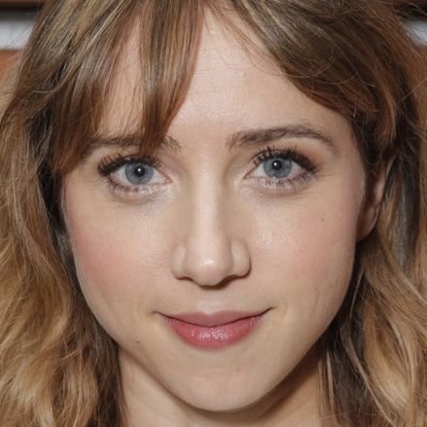


Dataset
We used “Kaggle” website to download dataset of face reaction. The dataset is composed of 7categories(reactions).
each category includes 3423 type jpg images for train and 380 for test.
The used reactions are: “happy”, “sad”, “surprise”
happy
sad
surprise

Slide 18
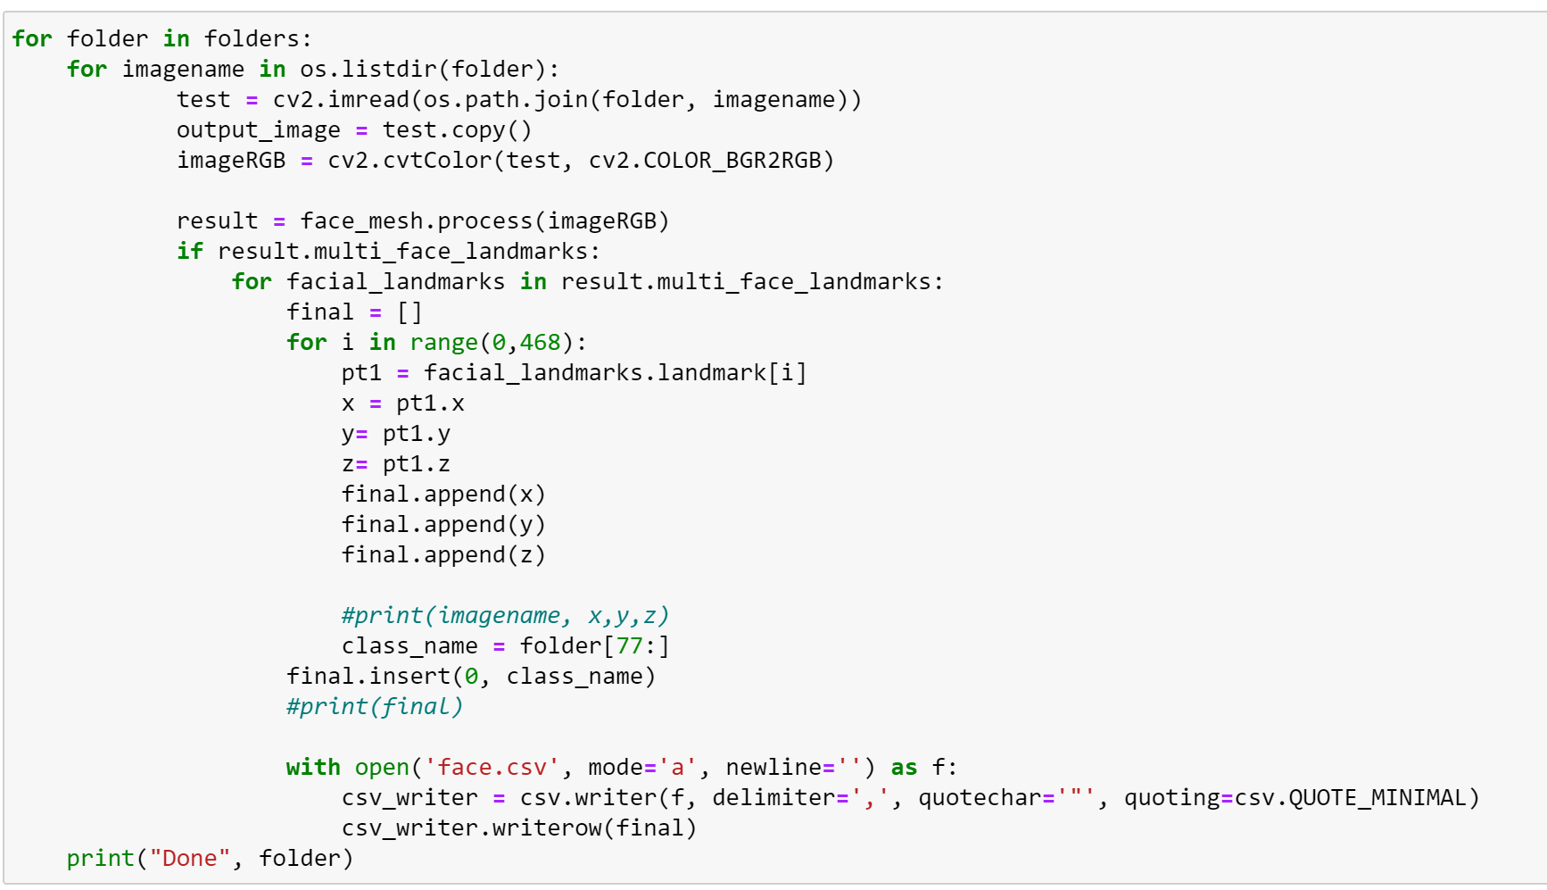
Detecting keypoints

Slide 19
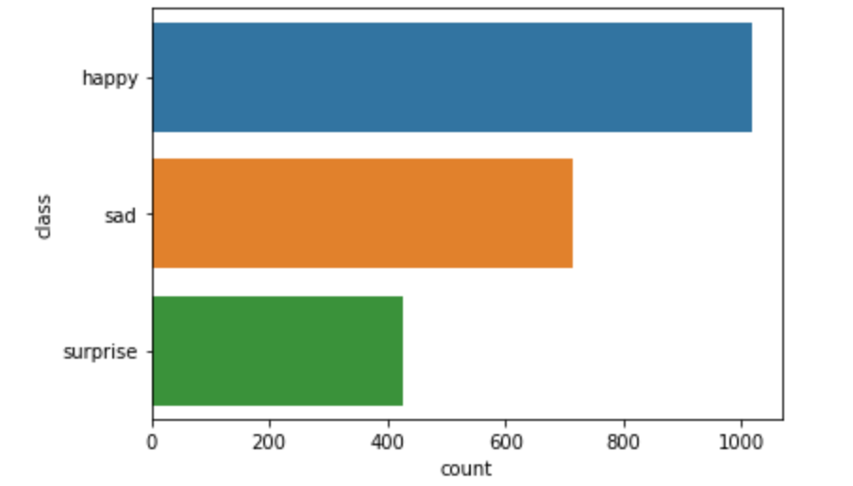
Data Exploration
Our Data became 2158 row and 1401 columns (467 point * 3 coordinates)
Happy has 1019 record, surprise has 425 and sad has 713

Slide 20
Machine Learning Model
Our data is divided to be 70% training data and 30% testing data.
We have chosen Random Forest Classifier model after tuning parameters as:
max_features = 500, max_depth = 50, n_estimators = 300, n_jobs = -1 and verbose = 2
Our Test accuracy is 80%

Slide 21

The result

Slide 22
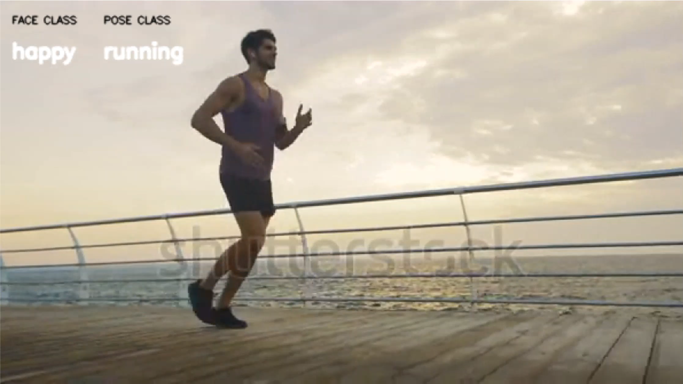

Slide 23
References
https://www.kaggle.com/kreinisalex/telemoji
http://vision.stanford.edu/Datasets/40actions.html
https://www.robots.ox.ac.uk/~vgg/data/pose/
https://github.com/hueihan/Action_Recognition/tree/master/data/WIS/video

Slide 24
Thank you

